Slide 1
Smart Home Automation and Security System Prototype
Michael J. Miller
DeVry University
College of Engineering & Information Sciences
CEIS101

Slide 2
Introduction
This project will design and test a home security and automation system. The system will monitor various conditions in the home, have LEDs to indicate status, and will report necessary data through serial monitor.
Requirements
Design and test project in Tinkercad
Program the system using the Arduino IDE
Use Arduino Mega 2560 to prototype and integrate the following systems
Door opened/closed sensor
Distance sensor to detect home intruder
Automated lights that turn on when dark
Water level/Flood sensor
Temperature and humidity sensor

Slide 3
Tinkercad design

Slide 4
Project schematic

Slide 5
inventory of Project Components
U1 | 1 | Arduino Mega 2560
D3 | 1 | Red LED
D1 | 1 | Green LED
D2 | 1 | Yellow LED
PIEZO1 | 1 | Piezo Buzzer
DIST1 | 1 | HC-SR04 Ultrasonic Distance Sensor
R2 | 1 | Photoresistor
R1 | 1 | 10 kΩ Resistor
U2 | 1 | DHT11 Temperature and Humidity Sensor
SEN1 | 1 | Water Level Sensor

Slide 6
Humidity/temperature sensor
Code and serial monitor output

Slide 7
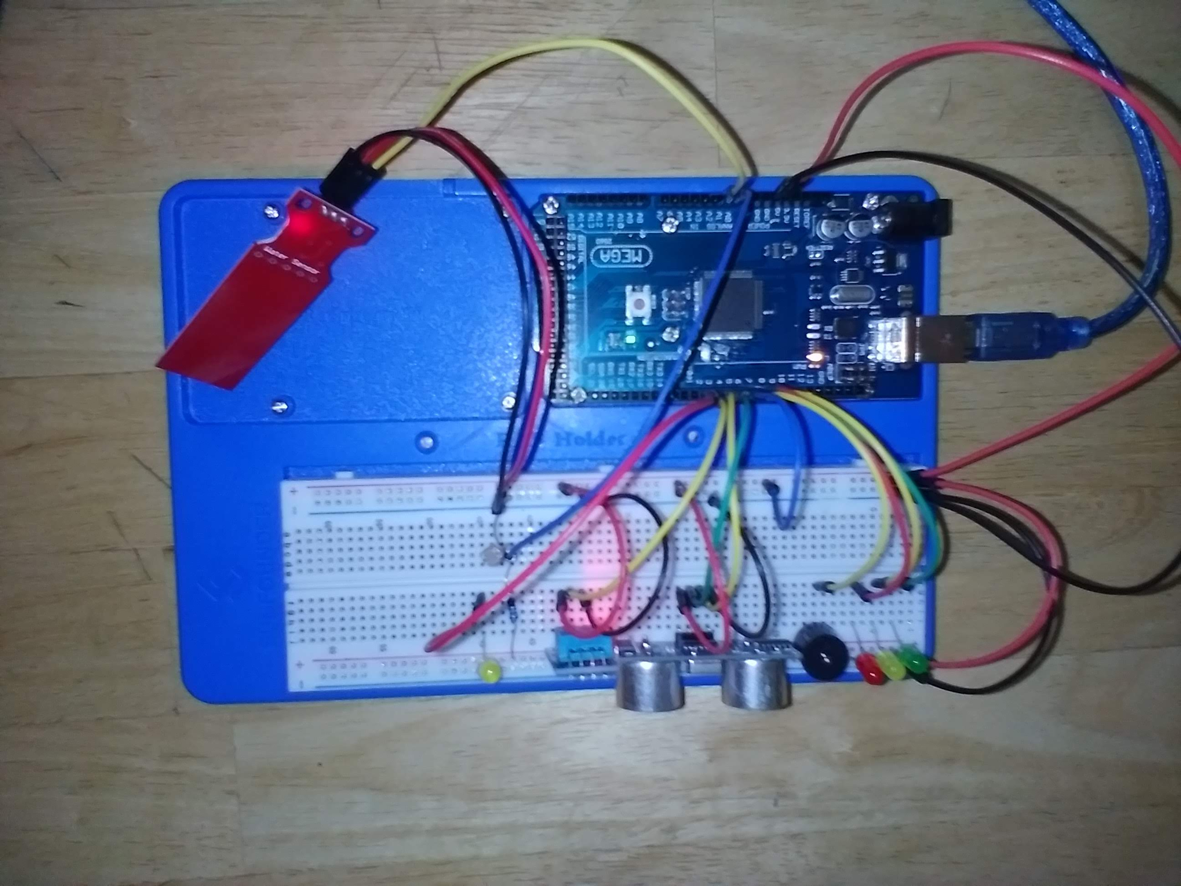
Automated Light
Automated Light off
Automated light on, finger covering photocell

Slide 8
Automated Light
Code and serial monitor output

Slide 9
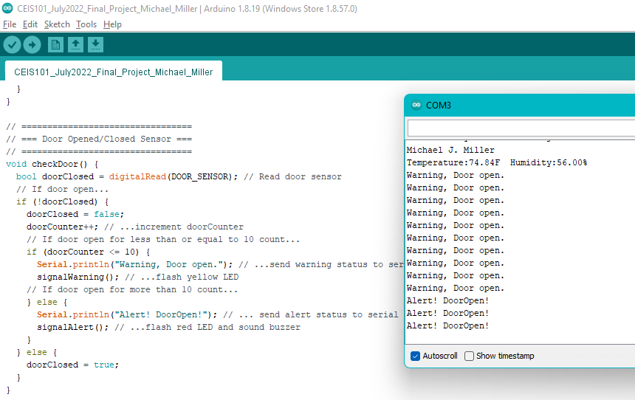
Door opened/closed Sensor
Door closed, Blue wire to +5vdc, green led on steady
Code and serial monitor output

Slide 10
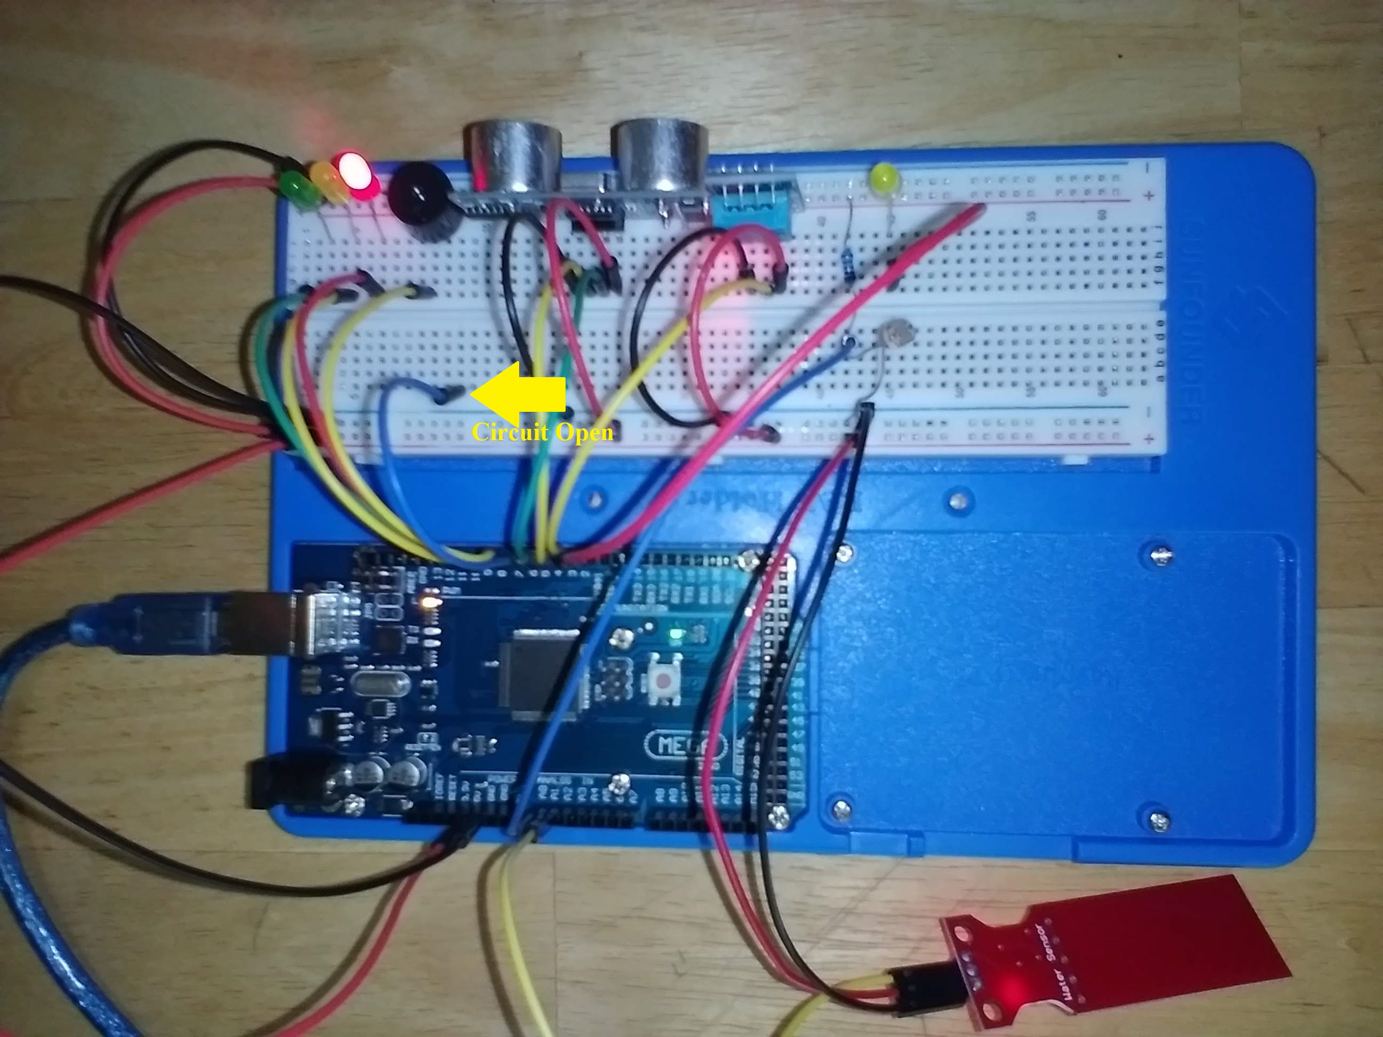
Door opened/closed Sensor
Door open for short period, Blue wire open circuit, yellow led flashes
Door open for longer period, Blue wire open circuit, red led flashes, and buzzer sounds

Slide 11
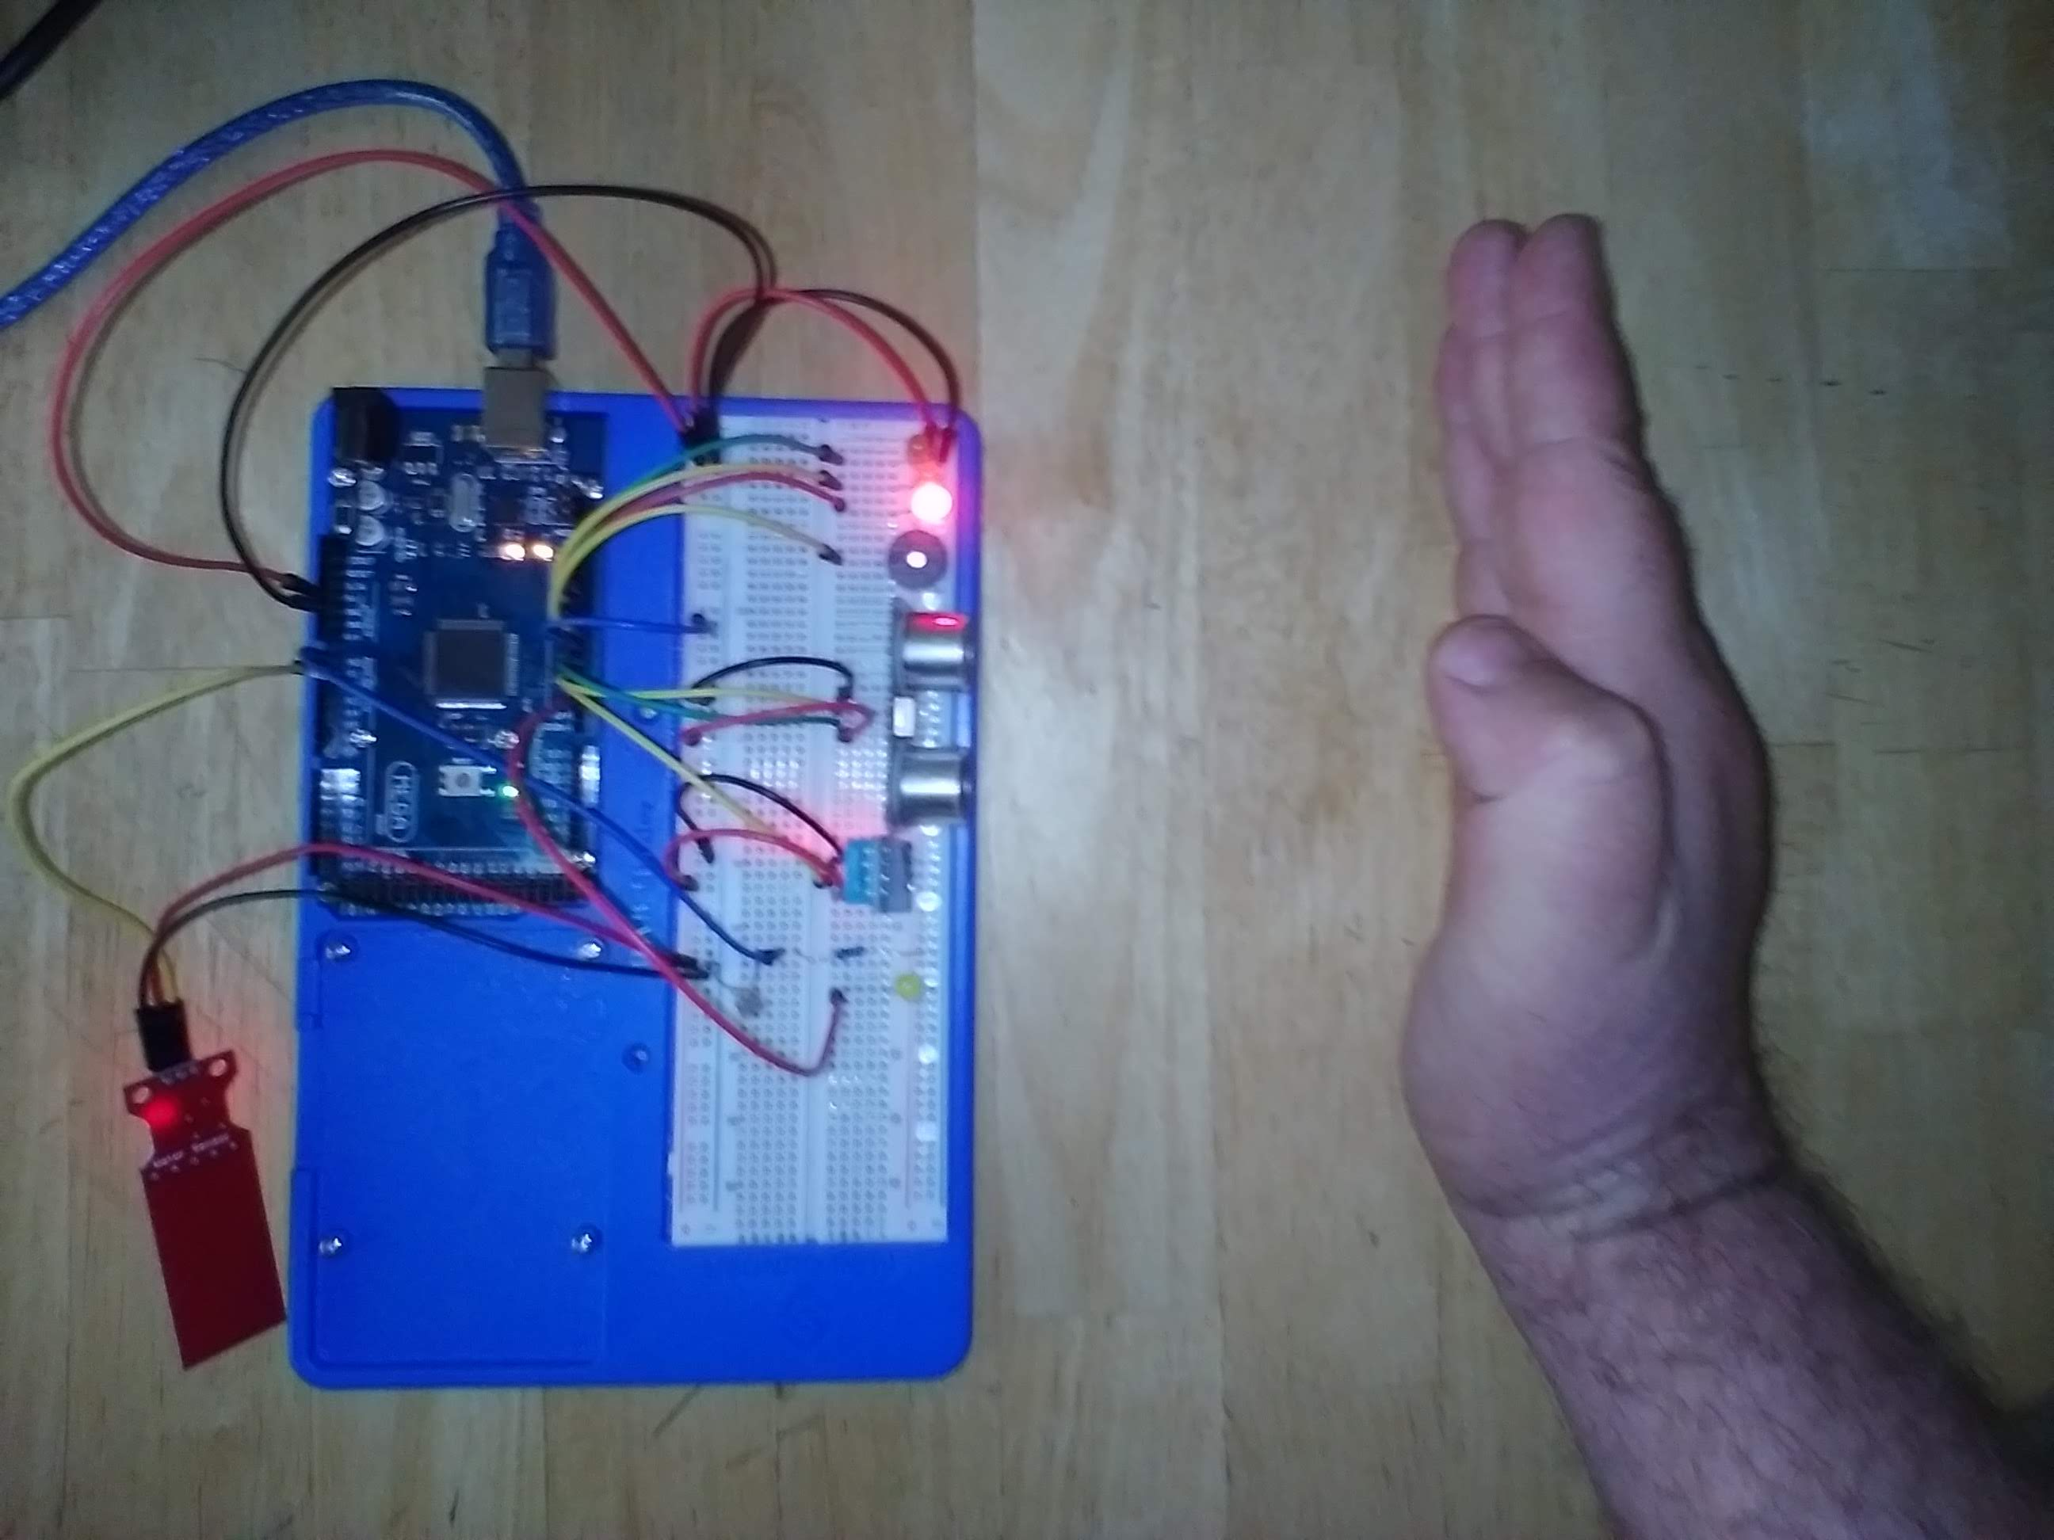
Intruder/Distance sensor
Intruder warning, object within 12 inches, but more than 6 inches, flashing yellow led
Intruder alert, object within 6 inches, flashing red led and buzzer sounded

Slide 12
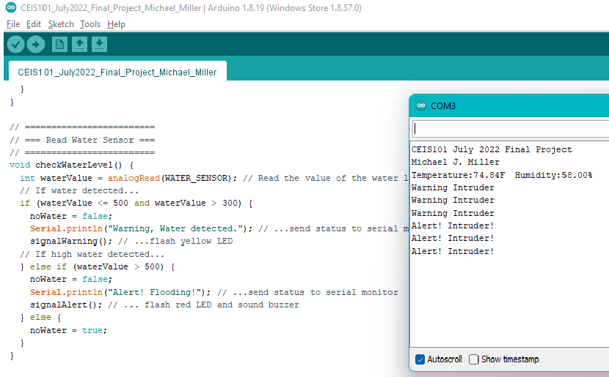
Intruder/Distance sensor
Code and serial monitor output

Slide 13
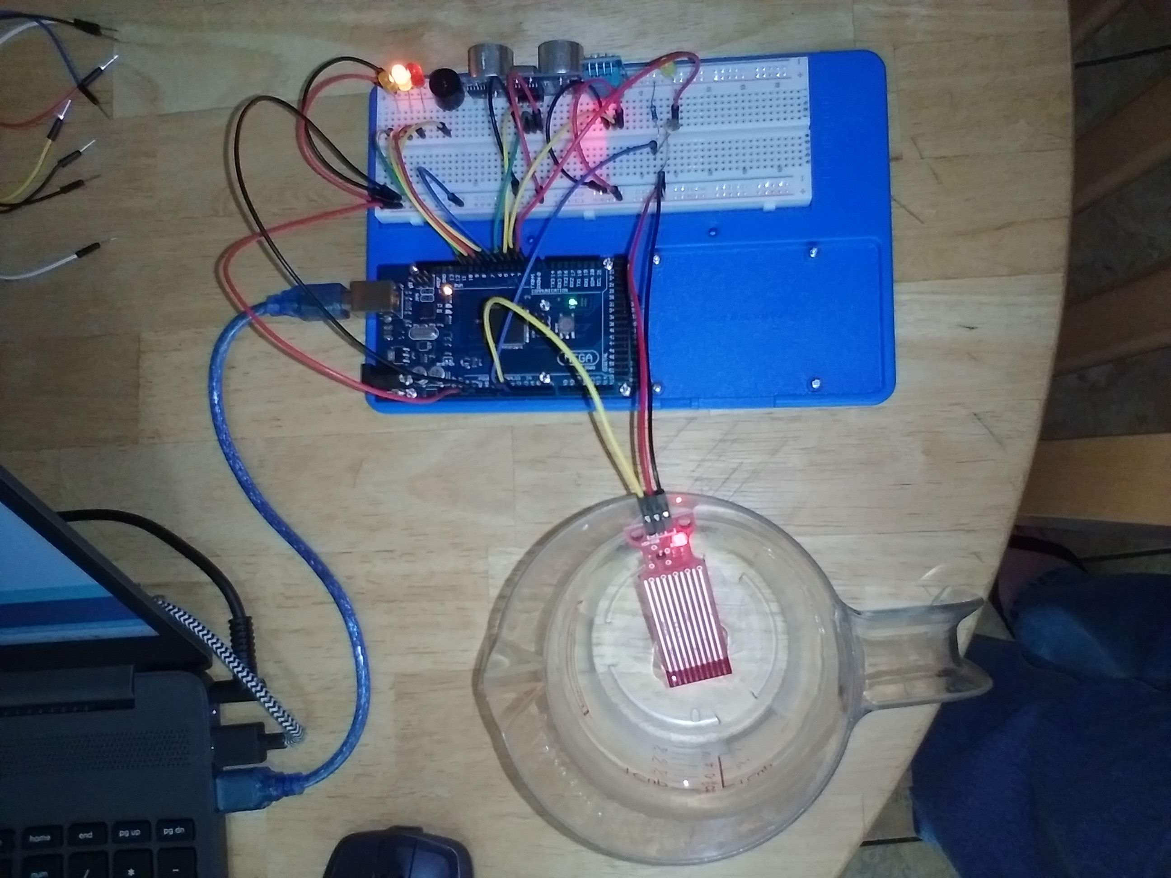
Water level/flood sensor
Low water, yellow led flashing
High water, red led flashing and buzzer sounded

Slide 14
Water level/flood sensor
Code and serial monitor output

Slide 15
Skills gained
Arduino coding and prototyping
Arduino sensor integration and coding
Reading and referencing technical data sheets for electronic components
IoT prototyping
Tinkercad designing and prototyping
Microsoft PowerPoint presentation creation

Slide 16
Challenges
REFACTORING CODE TO FUNCTIONAL PROGRAMMING STYLE
For efficiency and ease of reading I refactored the code to conform to a functional programming style.
INTEGRATING MULTIPLE COMPONENTS INTO ONE CODE BASE
Organizing code to check multiple sensors in a continuous loop
Sensor data, warnings, alerts, and serial monitor comms must not conflict and should be easy to understand by any user
CODING THE WARNINGS AND ALERTS FROM MULTIPLE SENSORS INTO ONE SYSTEM
The warning and alert system was written so that more than one alert can occur at the same time and not conflict.
Also, once sensors detect normal conditions, alerts and warnings should be cleared from the system.

Slide 17
Conclusion
This was a great project to work on. The experience and confidence I gained will benefit me throughout my time at DeVry and in my career after that. Even though I had prior experience with Arduino, I was able to challenge myself and take the code to the next level by incorporating functional programming. I also read the documentation to learn the different variable types used by Arduino and what effect they had on memory use.

