Slide 1
Course Project
Michael Miller
College of Engineering and Information Sciences, DeVry University
SEC 290: Fundamentals of Infrastructure Security
Professor Rami Salahieh
August 26, 2023

Slide 2
Introduction
Objective
Summarize the weekly projects completed for SEC290 – Fundamentals of Infrastructure Security
Topics Covered
Intrusion analysis using Wireshark
Open SSL
Snort
Live memory analysis
iptables for Network Defense

Slide 3
Intrusion Analysis Using Wireshark
Basic attack analysis
Look at captures no. 20 and 22. (You can use the “Go” link at the top of the Wireshark screen to quickly go to a specific capture) Both packets are ICMP traffic but there are subtle differences between them. Compare the time-to-live and data field sizes in the two packets. What differences do you see?
Packet 20 has a time-to-live of 64 and data field size of 56 bytes Packet 22 has a time-to-live of 128 and data field size of 32 bytes
Do a little Internet research to discover which operating systems use the specific values in their ping commands. What operating system generated the echo request in capture 20?
Linux originate ping requests with the default time to live of 64, while windows uses 128 (Sk, 2021). Packet 20 looks like it came from a Linux system.
Review packet no. 37 and beyond, what do you think is taking place here? __________________
The source (192.168.25.200) is scanning for open ports on the destination (192.168.21.1)
Look at capture 22846. What is suspicious about the flag settings in this packet?
It looks like the source is attempting a TCP FIN scan on port 1488 of the target. In this type of scan a FIN packet is sent to the target expecting an RST response. If there is no response, then the port is considered open. This type of scan is considered stealthier than a regular SYN scan, but unreliable because some OSs respond with RST even on open ports (Kacherginsky, 2008).
What is the IP address of the host being targeted?
192.168.25.1

Slide 4
Open SSL
Creating and testing an SSL/TLS file
Screenshot of the Wireshark output showing a GET request in the Info column.

Slide 5
Open SSL (cont’d)
Creating and testing an SSL/TLS file
Screenshot of the Wireshark output showing the decrypted SSL stream.

Slide 6
Snort
Testing Snort rules
Screenshot of the SGUIL output showing the transcript of the XMAS scan alert

Slide 7
Snort (cont’d)
Testing Snort rules
Screenshot of the Wireshark output showing the TCP packets generated by the XMAS scan.

Slide 8
Snort (cont’d)
Creating Snort rules
Screenshot of the SGUIL output showing the ping activity alert.

Slide 9
Snort (cont’d)
Creating Snort rules (cont’d)
Screenshot of the Wireshark output showing the ICMP packets generated by the ping activity.

Slide 10
Live Memory Analysis
Linux Processes
Screenshot of the output after running the “lsof –i tcp” command.
It shows port 55000 open for both IPv4 and IPv6.

Slide 11
Live Memory Analysis (cont’d)
Processes Hacker
Screenshot of Process Hacker showing the properties of the rundll32.exe process.

Slide 12
Live Memory Analysis (cont’d)
Processes Monitor
Screenshot of Process Monitor showing ifFaceName in the Path column and Data: Roman in the Detail column.

Slide 13
iptables for Network Defense
Time-based Access
Screenshot of the “netstat -rn” command to verify the DMZ Route Table settings.

Slide 14
iptables for Network Defense (cont’d)
Time-based Access (cont’d)
Screenshot of ping command verifying connectivity between the Ubuntu Web VM and the DMZ VM.

Slide 15
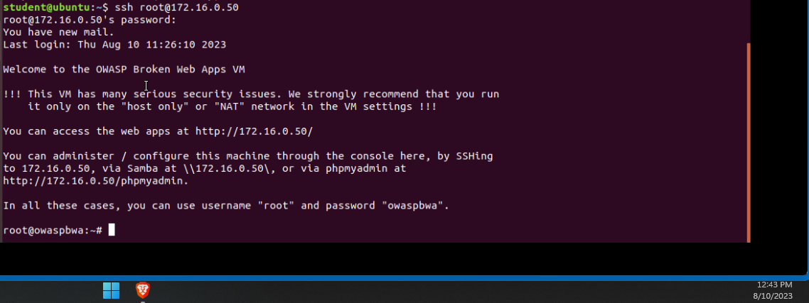
iptables for Network Defense (cont’d)
Time-based Access (cont’d)
Screenshot 1 shows time-based access rules in the FORWARD chain
Screenshot 2 verifies connectivity with the above rules enabled

Slide 16
Project Challenges
Wireshark
Getting familiar with Wireshark and learning the depth of information it provides
Snort/SGUIL
Learning what Snort is and how the SGUIL application is used for configuration
Memory Analysis
Getting to know the strengths and limitations of analyzing memory dumps

Slide 17
Career Skills Obtained
Using Wireshark for network traffic and packet analysis
Familiarity with Snort for Network Intrusion Detection
Using iptables for firewall configuration
A strong understanding of Open SSL encrytption and usage

Slide 18
Conclusion
Completed Objectives
Intrusion analysis using Wireshark
Open SSL
Snort
Live memory analysis
iptables for Network Defense

Slide 19
References
Infosec Learning. (n.d.). DeVry SEC 290 - Module 3: Open SSL Project
Kacherginsky, P. (2008). Port scanning techniques. https://iphelix.medium.com/port-scanning-techniques-7661839d182e
Prof. Rami, (July 21, 2023). Live lecture SEC290 DeVry University
Sk. (2021). Identify operating system using TTL value and ping. https://ostechnix.com/identify-operating-system-ttl-ping/

