Slide 1
Fundamentals of Information Technology and Networking
Michael J. Miller
College of Engineering and Information Sciences
NETW191 Fundamentals of Information Technology and Networking
Prof. Farooq Afzal
December 17, 2022

Slide 2
Introduction
The explosion of Internet of Things is inevitable. The potential use cases for this technology are seemingly infinite. This will create innumerable career paths and opportunities. At the root of the IoT is networking. In order to leverage this technology, a good understanding of networking is essential. The following slides will introduce some basic networking skills.
Topics Covered:
Addressing on Networks
Network Protocols and Routing
IP Subnetting and Loopback Interfaces
Network Diagrams
SOHO Wireless Network Security

Slide 3
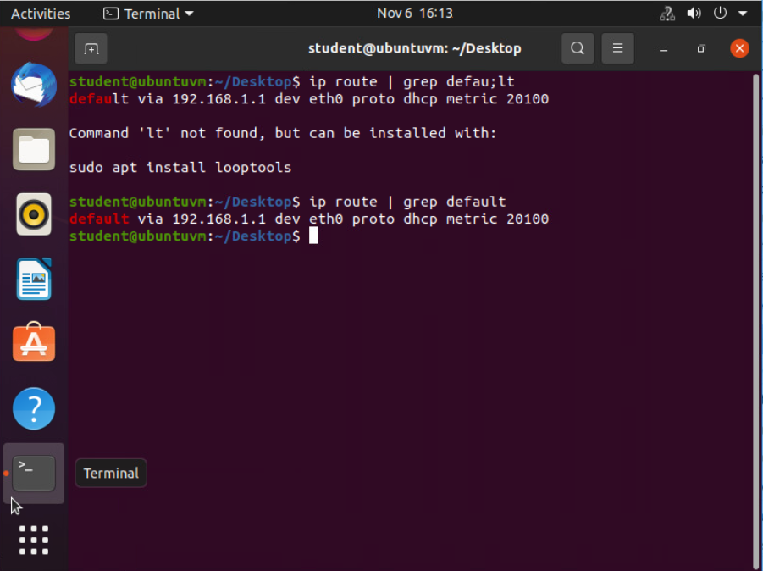
Addressing on Networks
All devices connected to a network need a unique address
MAC address
Device’s permanent id
IPv4/IPv6 address
Assigned by local network to each MAC address
Used for communicating within the network
May be manually or automatically chosen

Slide 4
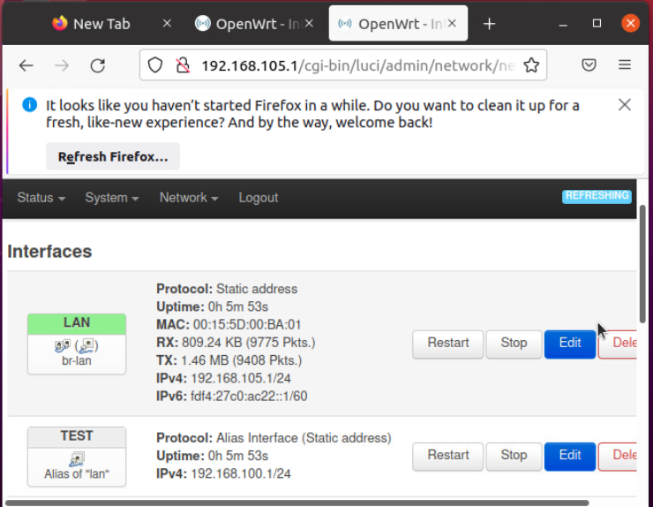
Addressing on Networks
DHCP (Dynamic Host Configuration Protocol)
Used to automatically assign IP address by the network
Default Gateway
Address a device accesses to communicate outside of local network
Subnet Mask
Used by devices to identify a network address’s host and network portions

Slide 5
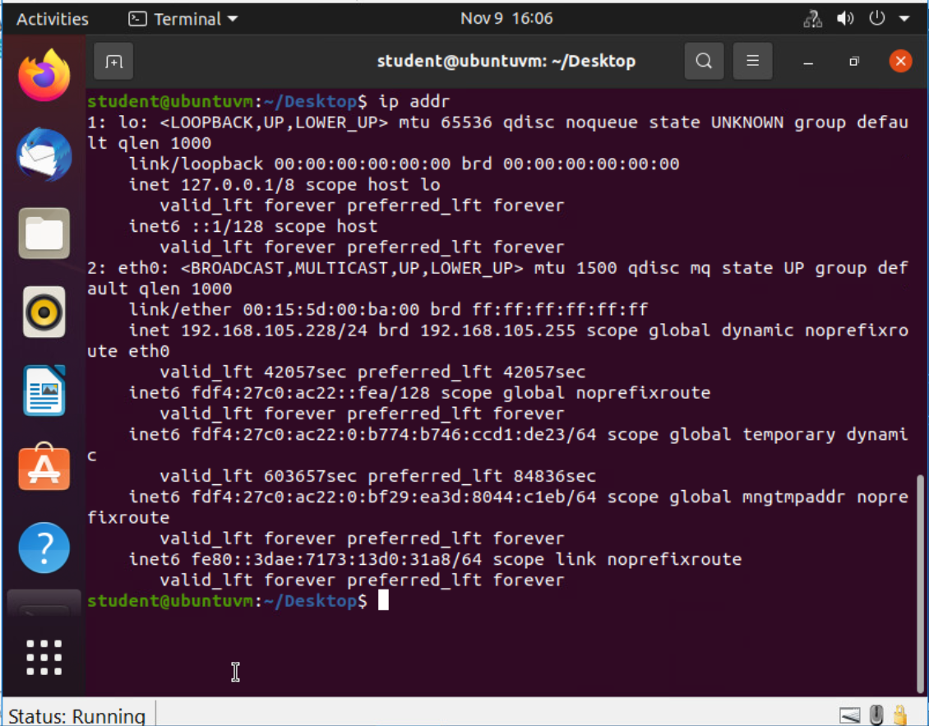
Network Protocols and Routing
TCP/IP Protocols
A protocol is a set of rules defining communication between devices and software
TCP/IP Protocol
TCP (Transmission Control Protocol)
IP (Internet Protocol)
Together they define how devices communicate within networks

Slide 6
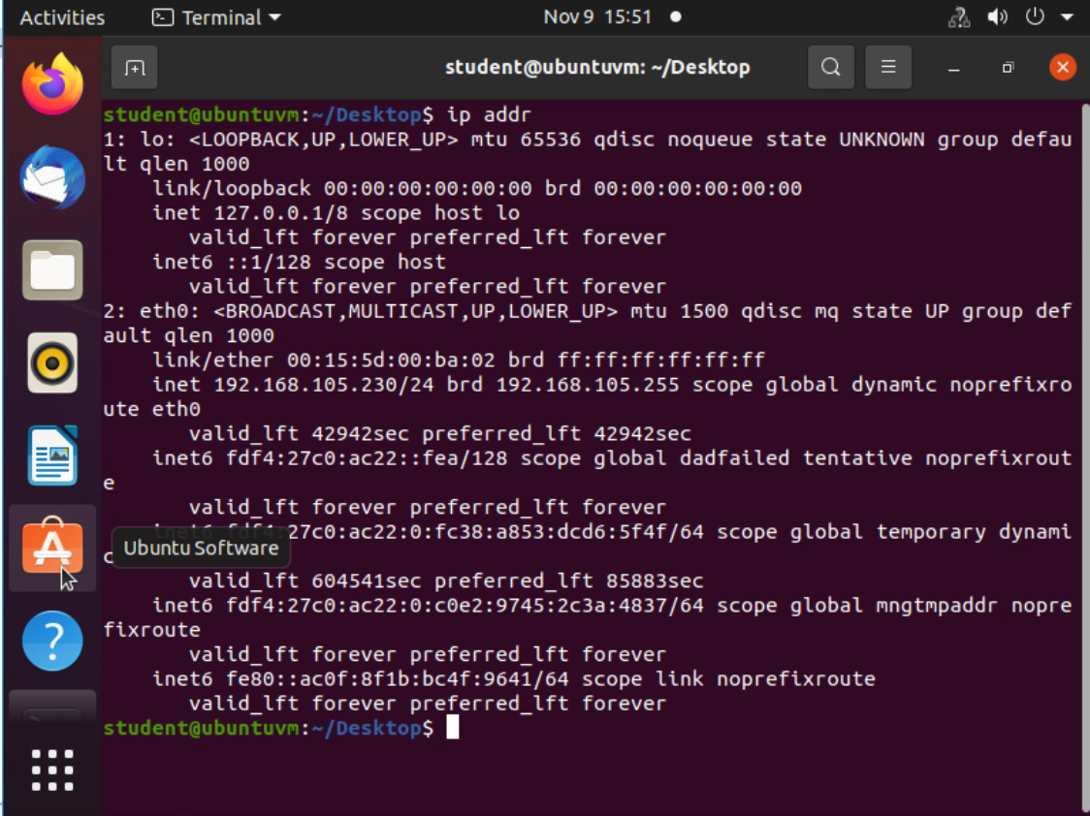
Network Protocols and Routing
Routers and Routing
Router
Device that serves as the center of a network
Controls how devices communicate with other devices
Allows access to and from other networks
Usually serves as the DHCP server for that network

Slide 7
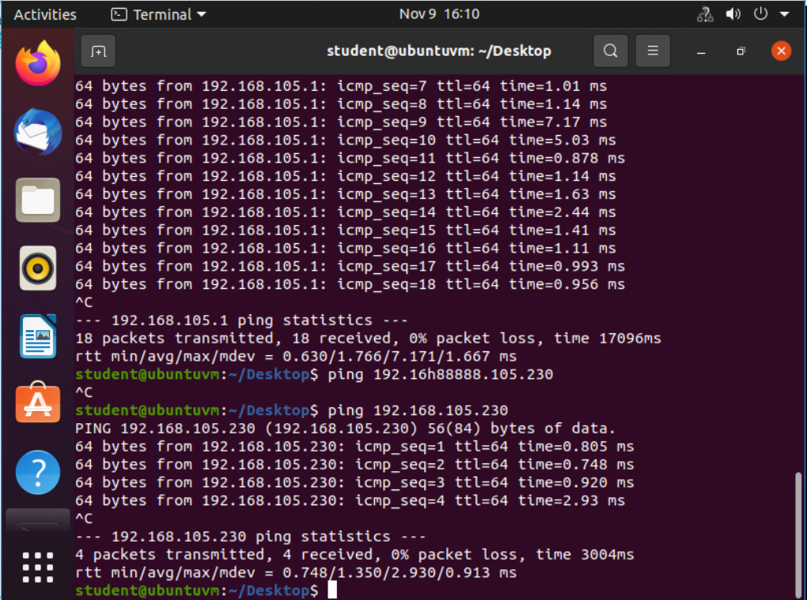
Network Protocols and Routing
Troubleshooting Route Issues
Common Issues
Duplicate MAC address
Hardware failure
Incorrectly configured IP address
Wrong default gateway
Incorrect subnet mask

Slide 8
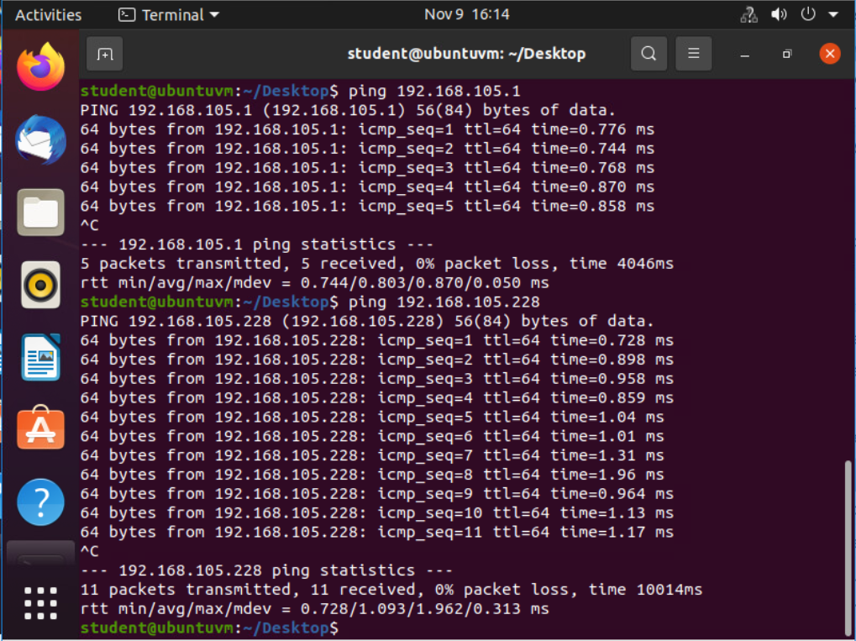
Network Protocols and Routing
Troubleshooting Tools
netstat
“displays TCP/IP statistics and details about TCP/IP components and connections on a host” ⁽¹⁾
tracert or traceroute
“trace the path from one networked node to another, identifying all intermediate hops between the two nodes” ⁽¹⁾

Slide 9
IP Subnetting and Loopback Interfaces
Subnetting Table
This table demonstrates how to subnet a network. It lists the subnet notation, network address, first usable host address, last usable host address, and broadcast address of each subnet.
Subnet | Subnet Notation | Network Address | First Usable Host Address | Last Usable Host Address
The First Subnet | 255.255.255.128/25 | 192.168.5.0 | 192.168.5.1 | 192.168.5.126
The Second Subnet | 255.255.255.128/25 | 192.168.5.128 | 192.168.5.129 | 192.168.5.254

Slide 10
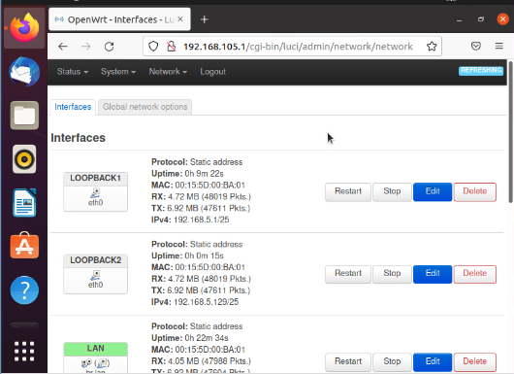
IP Subnetting and Loopback Interfaces
Loopback Address
“An IP address reserved for communicating from a node to itself, used mostly for troubleshooting purposes” ⁽¹⁾
Sometimes refered to as the localhost
The image to the right shows the configuration of two loopback interfaces defining separate subnets within a network.

Slide 11
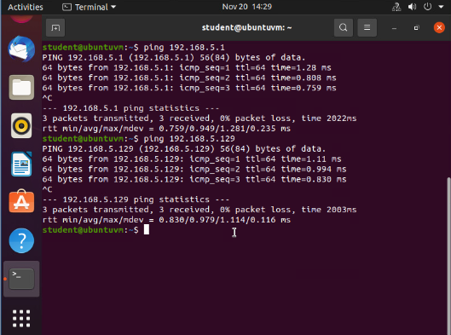
IP Subnetting and Loopback Interfaces
Connectivity Tests
ping
Utility used to test connectivity between devices on a network
Sent to any valid IP address or domain name
Reports back
# bytes sent and received
IP address of target host
Sequence number
Latency or time it took to receive a response

Slide 12
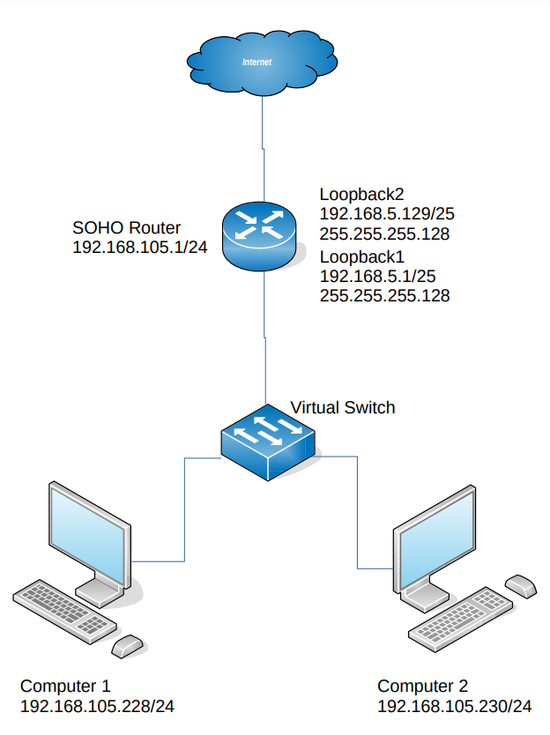
Network Diagram
Visual representation of a networks physical structure
Shows devices connected to the network and what type of device
Should list IP addresses and assigned names of the devices
Very useful when modifying or troubleshooting a network
Image shows a network with a router, switch and two terminals, the network is divided into two subnets, and the router is connected to the internet.

Slide 13
SOHO Wireless Network Security
What are the factory default username and password of a TP-Link router? Why is it important to change the default username and password of a SOHO router?
Answer: admin, admin, If the username and password are not changed from default then anyone can access the admin settings of the router.
To protect a SOHO wireless network with a small number of devices, which address management method provides more control, configuring the device IP addresses manually (static IP) or using a DHCP server (dynamic IP)? Why?
Answer: More control over the devices on the network is gained by making the router a DHCP server. This allows for the router admin to control the IP addresses, lease time, gateway IP, and DNS servers of all clients connected to that network. Otherwise these settings are controlled by each client individually and not the router’s admin.
What does MAC filtering do? If needed, when would you use deny filtering rules and when would you use allow filtering rules? What happens to devices that want to connect, if the “Allow the stations specified by any enabled entries in the list to access” function is enabled but there are no entries in the list?
Answer: MAC filtering allows for choosing the devices that are either allowed or denied access to the network by their MAC address. Deny filtering rules could be used to deny access to a few known “bad actors”. Allow filtering rules could be used to allow only specific clients to access the network. If “Allow the stations specified” is selected and no stations are listed then no stations will be allowed to connect.

Slide 14
SOHO Wireless Network Security
What wireless security settings are displayed on the Wireless Security page? Which one is recommended by the vendor? Why?
Answer: The selections are “Disable Wireless Security”, “WPA/WPA2 - Personal”, “WPA/WPA2 – Enterprise”, and “WEP”. “WPA/WPA2 – Personal” is recommended by the by the vendor because it gives the best security available and is simple to set up and use.
Among the configurations you explored in this module, which one is a true security function? Why?
Answer: The only true security function explored is the “Wireless Security Settings”. This function is specifically designed to add security measures to the network. The other functions help with security, but that is not their only purpose.
What would you do to protect your wireless network at home? Why?
Answer: To protect my home network I would change the default username and password, enable the highest available security protocol, and if I wanted to be extra cautious I would enable MAC filtering to only allow the devices I added to the list.

Slide 15
Challenges
Network subnetting was the most challenging part of the term. It took time and practice to understand how the subnet mask was used to determine the new networks’ addresses.
Calculating binary numbers – although I first learned binary over thirty years ago, it took some time to relearn how it was done.
Using the lab virtual machines was a bit cumbersome. I’m sure it’s the best solution for a distance learning environment, but it was confusing to setup and use properly.

Slide 16
Career Skills
IPv4 and IPv6 network addressing
Network troubleshooting using tools like ping, netstat, and tracert or traceroute
Network subnetting
Reading network diagrams

Slide 17
Conclusion
The explosion of Internet of Things is inevitable. The potential use cases for this technology are seemingly infinite. This will create innumerable career paths and opportunities. At the root of the IoT is networking. In order to leverage this technology, a good understanding of networking is essential. The following slides will introduce some basic networking skills.
Topics Covered:
Addressing on Networks
Network Protocols and Routing
IP Subnetting and Loopback Interfaces
Network Diagrams
SOHO Wireless Network Security

Slide 18
References
West, J., Andrews, J., & Dean, T. (2021). CompTIA network+ guide to networks. Cengage.

