Slide 1
IoT Cloud Connected Traffic Light Prototype
Michael J. Miller
College of Engineering and Information Sciences
DeVry University
CEIS114 Introduction to Digital Devices
Dr. Genevieve Sapijaszko
December 17, 2022

Slide 2
Introduction
IoT technology has the potential to greatly impact cities and traffic control in several ways.
Sensors can be installed in traffic lights and road signs to monitor traffic flow and congestion.
Data can then be used to adjust signal timing and route traffic in real-time
Reduce congestion and improve the overall efficiency of the transportation system.
Potential to greatly improve the efficiency and safety of transportation systems
Enhance the quality of life in urban environments.

Slide 3
Project Goals
Design and implement a four-way traffic light controller system.
Attach an LCD display for viewing system status
Include a pedestrian crossing
Include a cloud-based control accessed via web browser
utilizing the IoT kit and ESP32 Microcontroller

Slide 4
Build Steps
ESP32 setup and testing
Add one set of traffic lights and control code
Add second set of lights and code
Add crosswalk button and code
Add LCD display and buzzer
Integrate cloud-controlled emergency alert

Slide 5
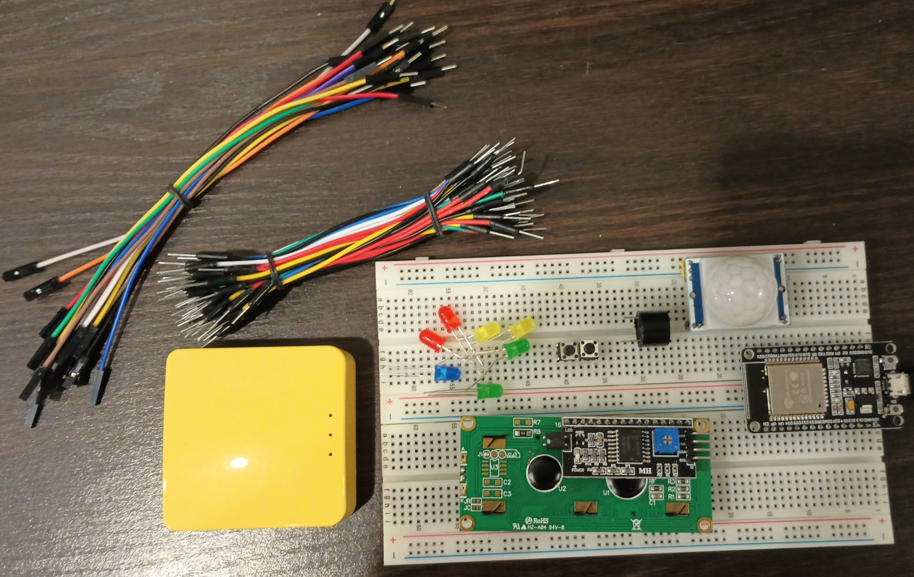
Bill of Materials
ESP 32 Board
Colored LEDs: Red, Yellow, Green, and Blue
220 Ohm Resistors (optional)
Wires
Breadboard(s)
LCD Unit with I2C Adapter
Active Buzzer
Mini Router
Push Button(s)
PIR Motion Sensor

Slide 6
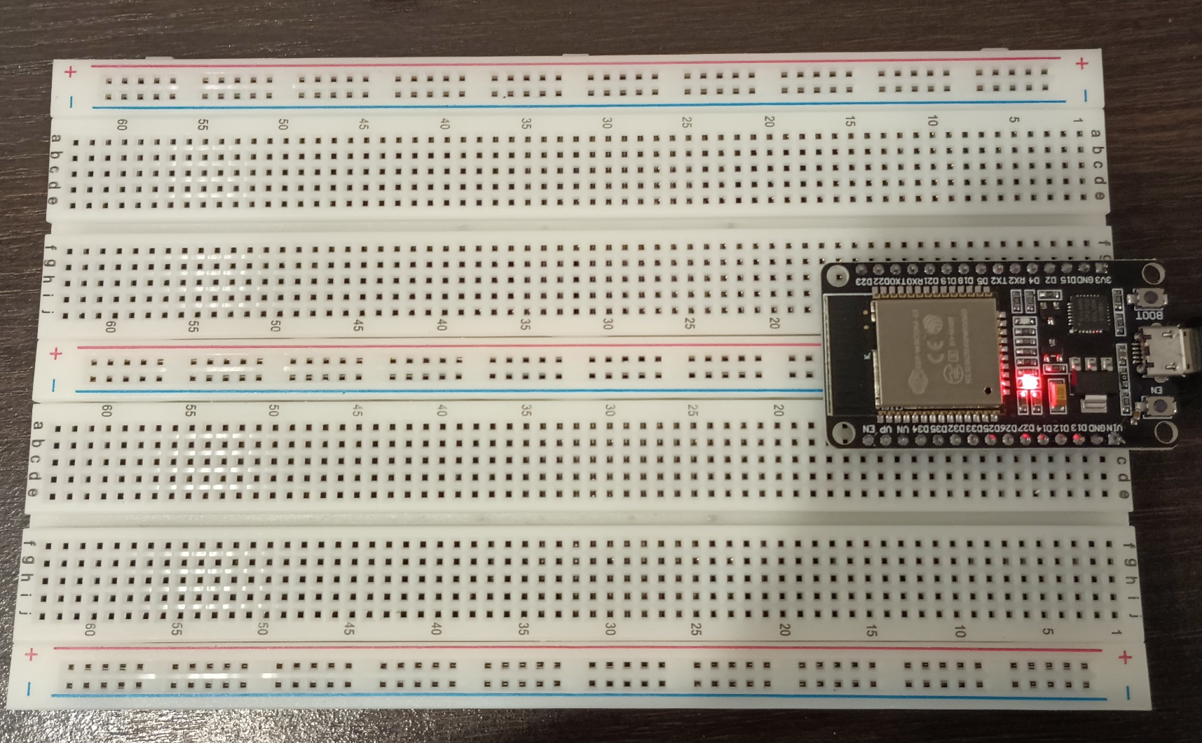
01
ESP32 Setup and Testing
ESP32 mounted on breadboard and powered on

Slide 7
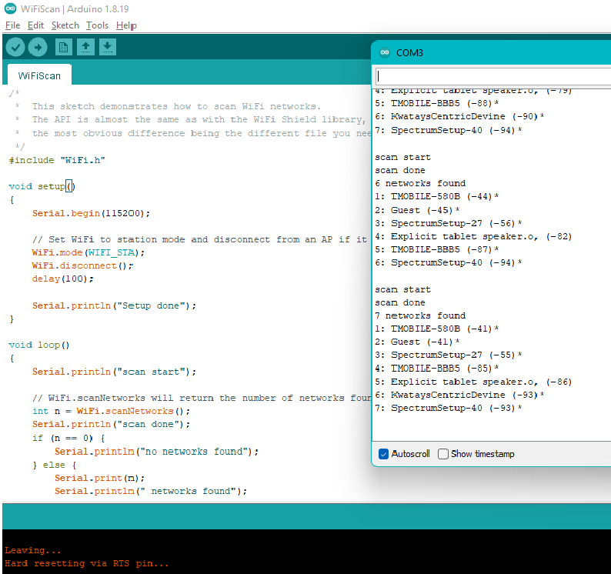
01 (continued)
ESP32 Setup and Testing
ESP32 WiFi Scan
Screenshot of Serial Monitor in Arduino IDE showing the available networks

Slide 8
02
Adding Traffic Lights
LED Lights
Lights cycle through properly
Capacitor
Added to eliminate the need to press boot button while uploading code

Slide 9
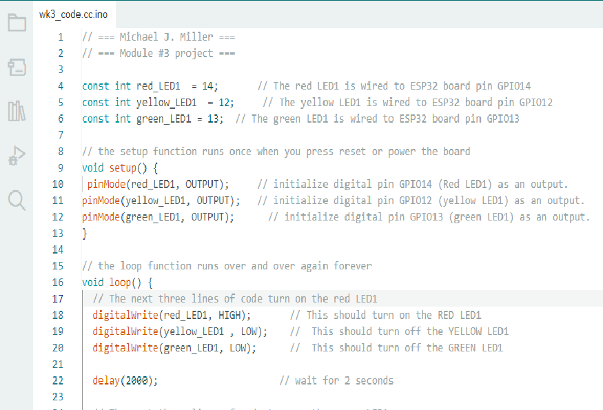
02 (Continued)
Adding Traffic Lights
Screenshot of code in Arduino IDE

Slide 10
03
Second Set of Lights
Picture of circuit with working LEDs

Slide 11
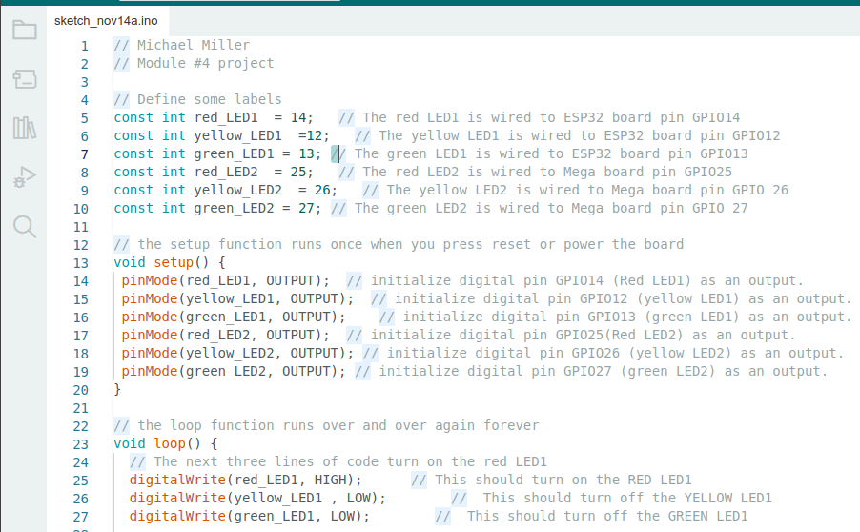
03 (Continued)
Code for Second Set
Screenshot of code in Arduino IDE

Slide 12
04
Crosswalk Button
Picture of circuit with working LEDs

Slide 13
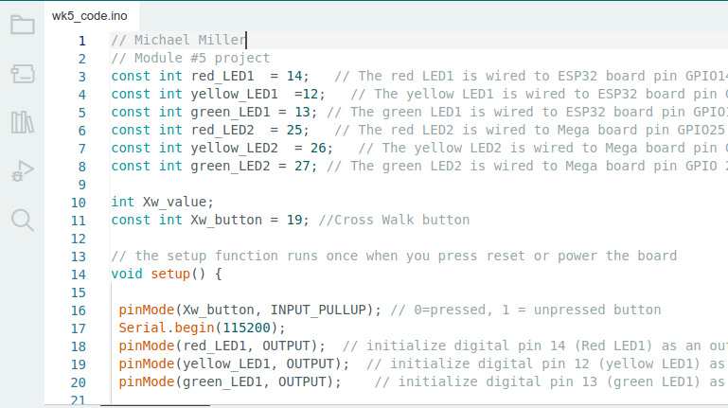
04 (Continued)
Crosswalk Button
Screenshot of code in Arduino IDE

Slide 14
04 (Continued)
Crosswalk Button
Screenshot of Serial Monitor in Arduino IDE

Slide 15
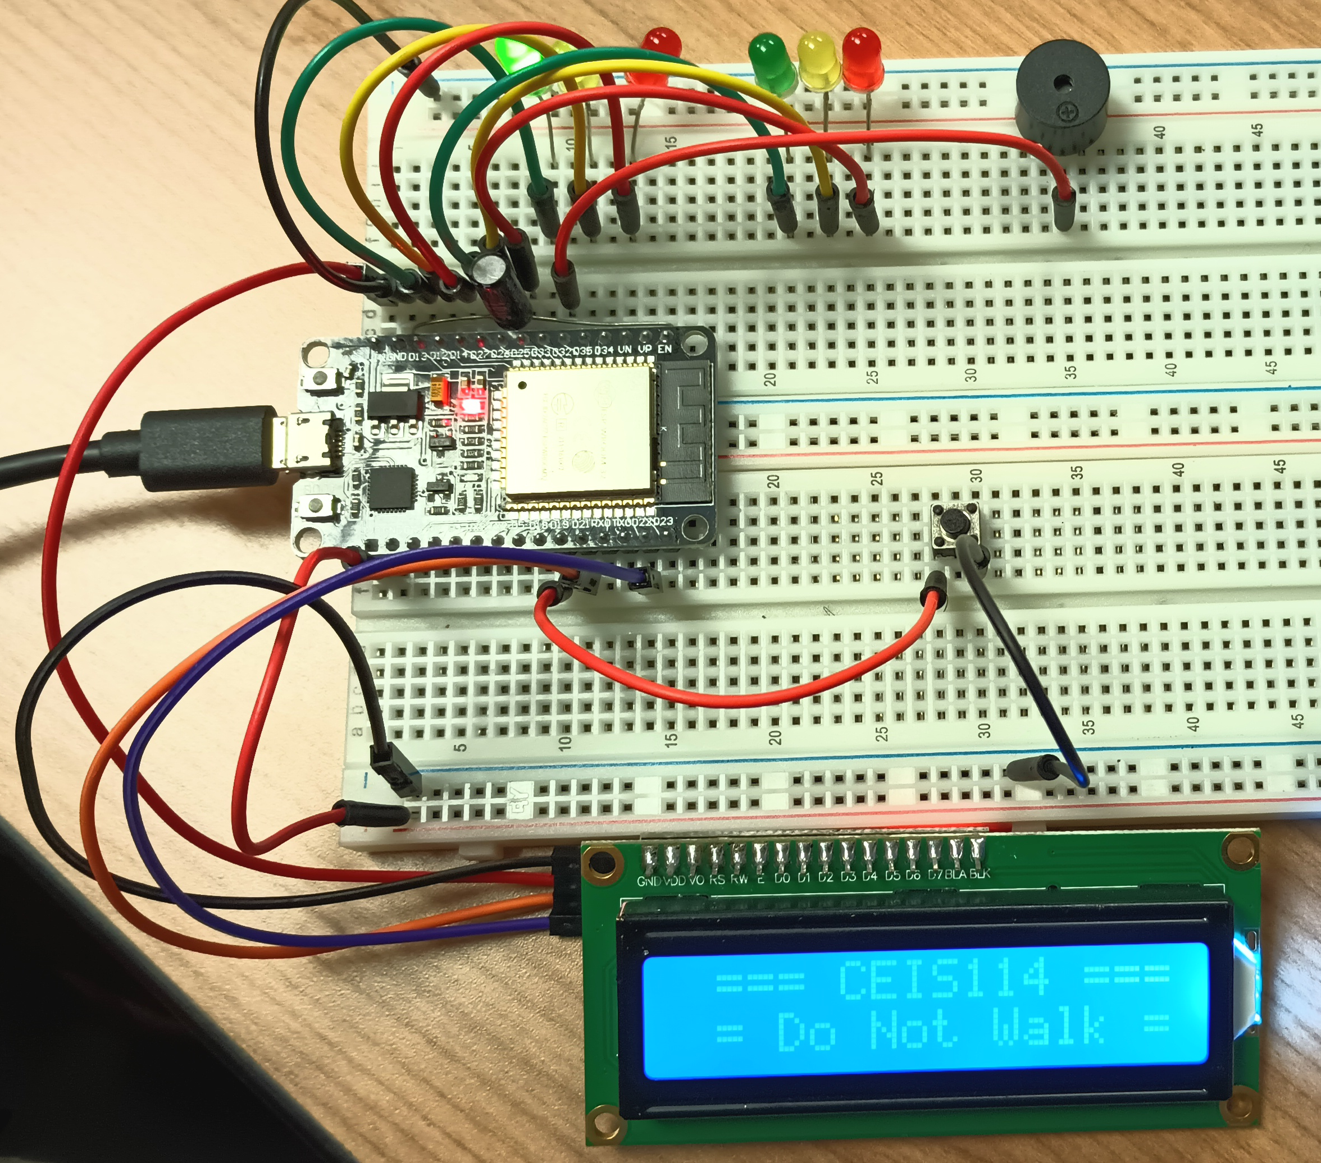
05
LCD Display and Buzzer
Picture of circuit with working LEDs and LCD display

Slide 16
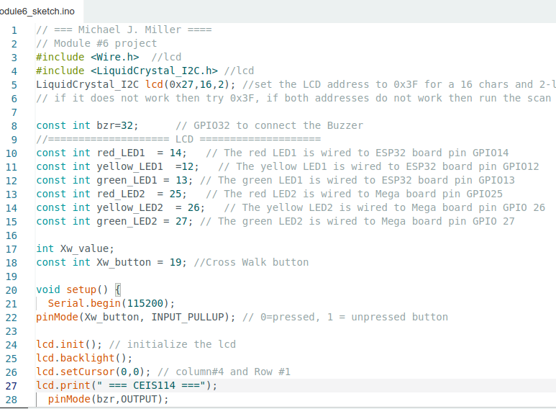
05 (Continued)
LCD Display and Buzzer
Screenshot of code in Arduino IDE

Slide 17
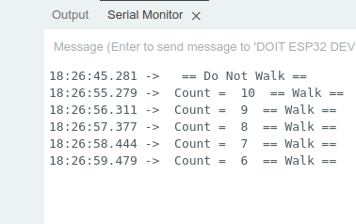
05 (Continued)
LCD Display and Buzzer
Screenshot of Serial Monitor in Arduino IDE

Slide 18
06
Cloud Controlled Emergency Alert
Screenshot of Dashboard on Arduino IoT Cloud
https://cloud.arduino.cc/
Emergency switch
Turns emergency mode on/off
Status light
Indicates successful change of mode, independent of switch

Slide 19
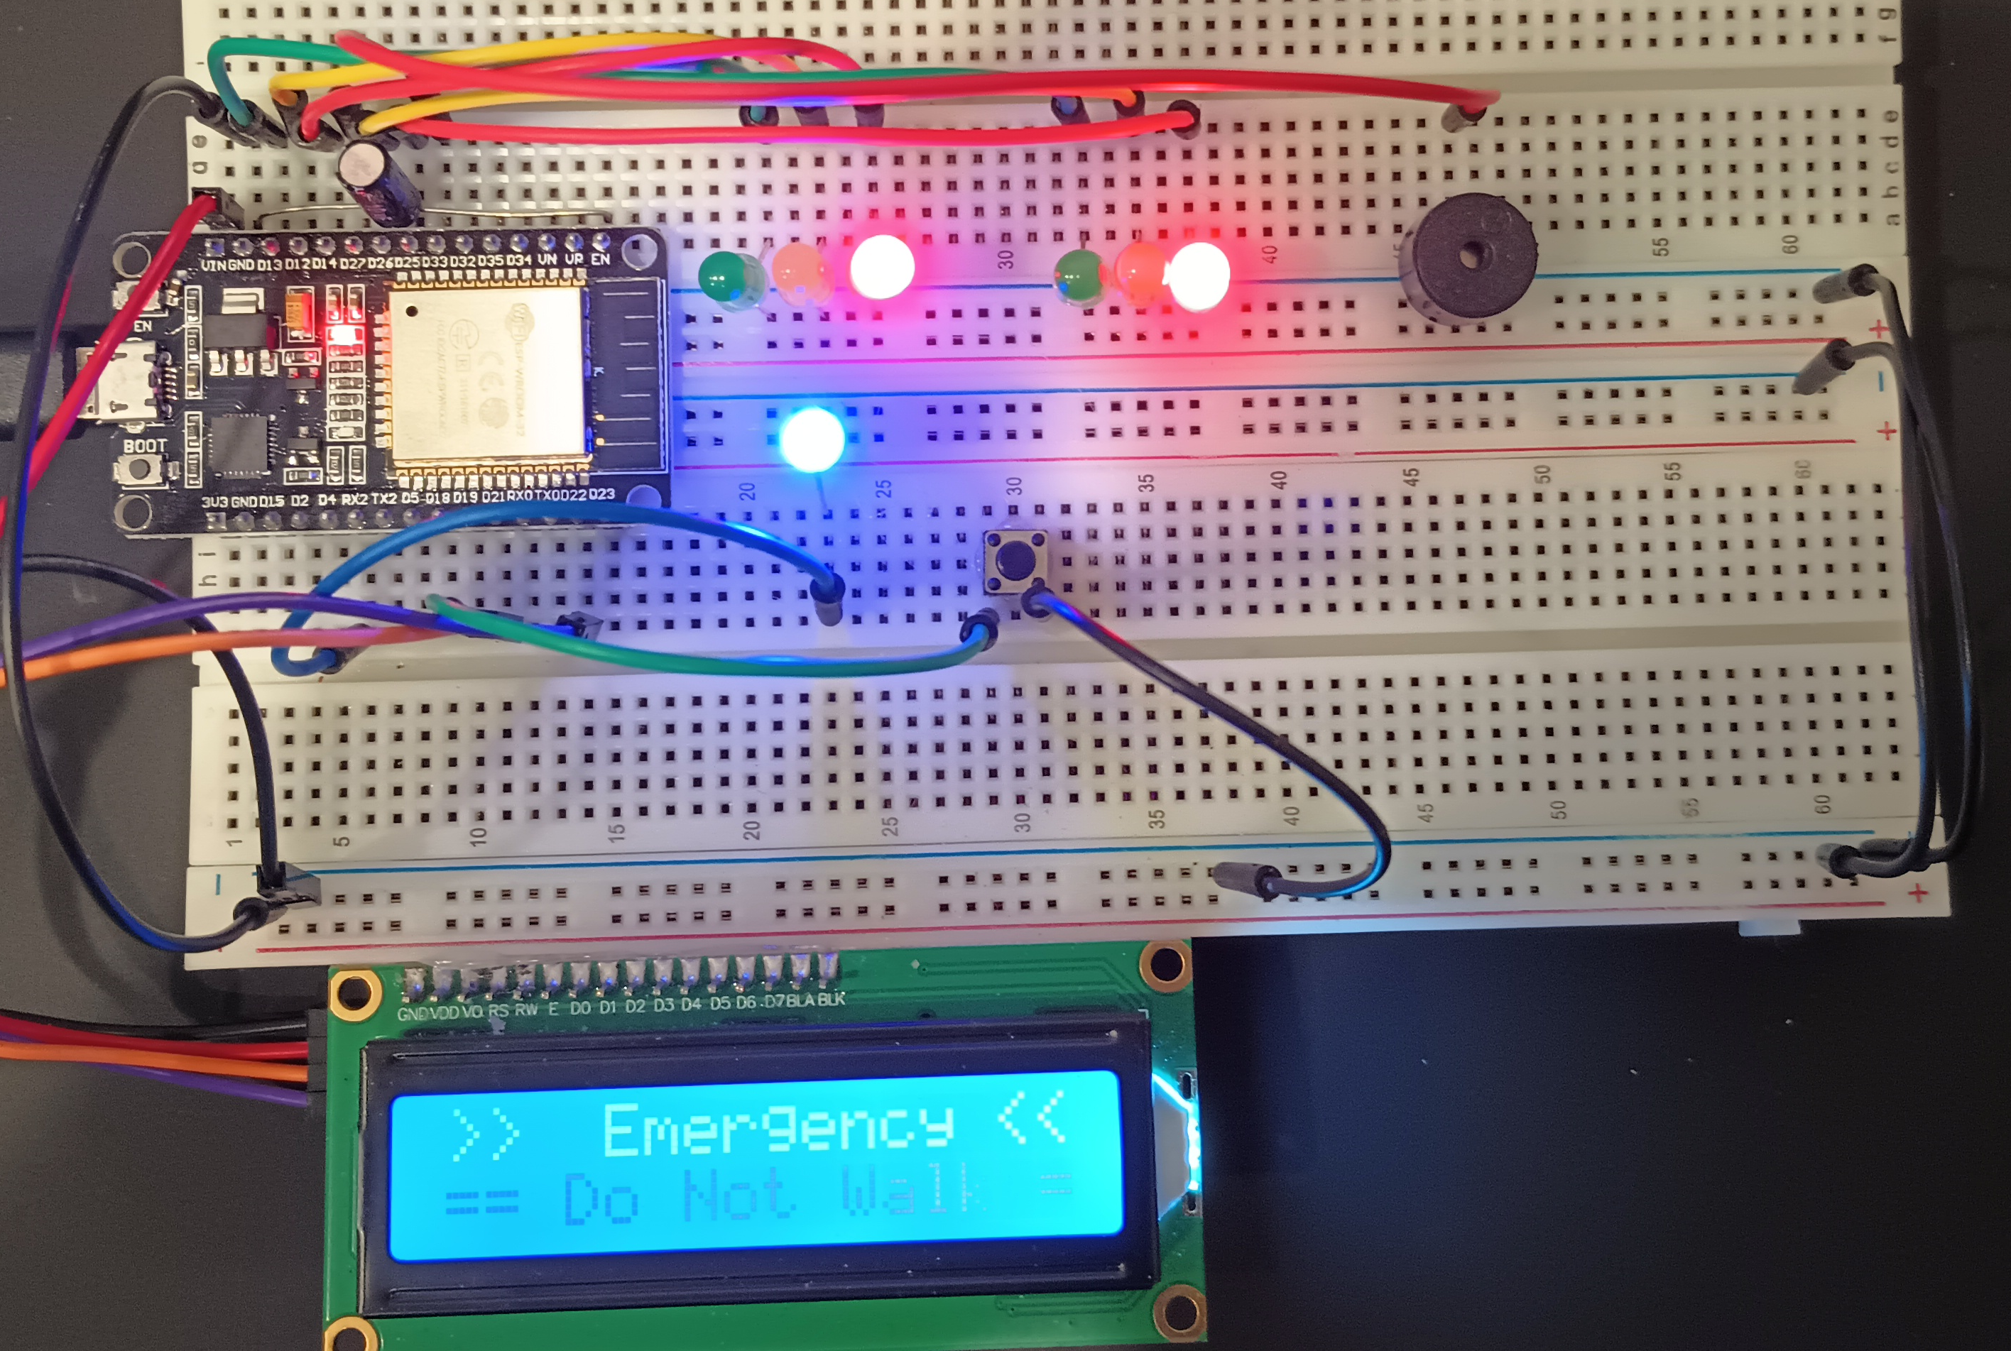
06 (Continued)
Cloud Controlled Emergency Alert
Picture of circuit with working LEDs and LCD display

Slide 20
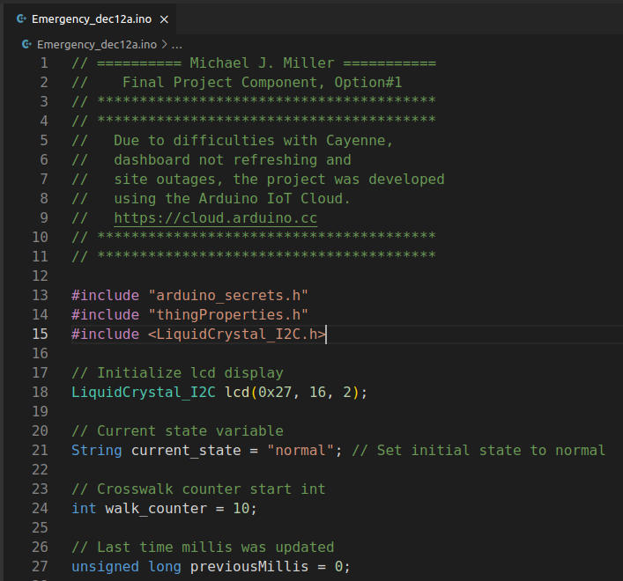
06 (Continued)
Cloud Controlled Emergency Alert
Screenshot of code in Visual Studio Code

Slide 21
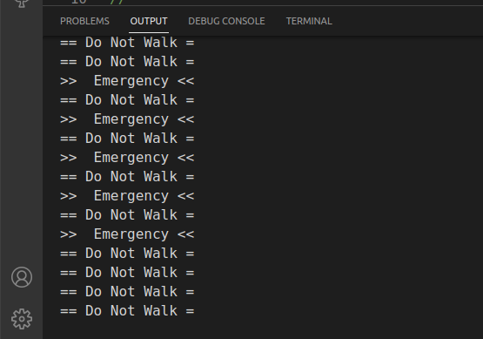
06 (Continued)
Cloud Controlled Emergency Alert
Screenshot of serial monitor in Visual Studio Code

Slide 22
Challenges
Cayenne Dashboard
The Cayenne website was down for a day which delayed completion. Once the dashboard was complete and communicating with the device the website would not reliably refresh after clicking the button to activate emergency mode.
Solution: Changed cloud provider to Arduino IoT Cloud
Arduino IoT Cloud
Although in the end it was a good decision to change cloud provider, learning the new platform without instructions was challenging.
Solution: Arduino’s documentation is well organized and easy to find the information needed. The UI for setting up the service was intuitive and relatively simple.
Code Refactoring
The code provide for the project was good for a working prototype. During the build phase it was used as is. After completion the code was difficult to read and included too much repetition of code.
Solution: The code was refactored and commented to allow for easier reading and minimize code repetition.

Slide 23
Career Skills
IoT prototyping
IoT WiFi integration
C/C++ coding
IoT cloud device control

Slide 24
Conclusion
IoT technology has the potential to greatly impact cities and traffic control in a number of ways.
Sensors can be installed in traffic lights and road signs to monitor traffic flow and congestion.
Data can then be used to adjust signal timing and route traffic in real-time
Reduce congestion and improve the overall efficiency of the transportation system.
Potential to greatly improve the efficiency and safety of transportation systems
Enhance the quality of life in urban environments.

Slide 25
THANK YOU
Yellow Idea Template for LibreOffice Impress. Credit by @ealita.id, 2020.

