Slide 1
Linux Operating System
An Introduction
Michael J. Miller
CEIS106
Oct 22, 2022
Professor Charlotte McKenzie

Slide 2
Introduction
What is Linux?
Operating system based on the Linux kernel
Released Sep 17, 1991 by Linus Torvalds
Free and open source
Typically packaged as “Distributions”
  Includes Linux kernel plus system software and libraries
Worlds top 500 fastest computers run on Linux
Android uses the Linux kernel

Slide 3
Navigate the Linux filesystem tree
Directory Structure
  Organized top down
  Root at top level
  Absolute pathname starts at root directory
Common commands
  cd – Change directory
    cd dir_name/ # relative pathname
    cd /usr/bin # absolute pathname
  ls – List files and folders in directory
    ls -a # List all files and folders including hidden ones

Slide 4
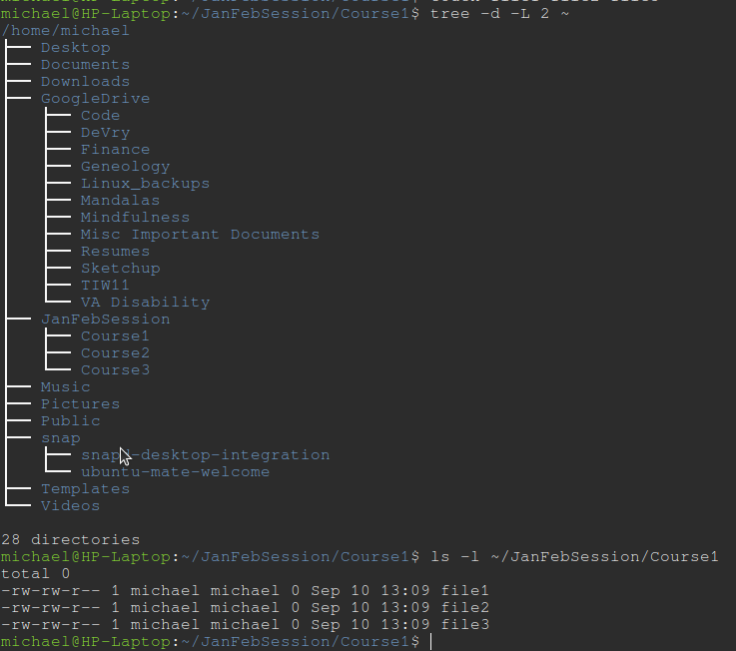
Examples
tree -d -L 2 ~
  list directories in tree format
  -d = directories only
  -L 2 = 2 levels deep
  ~ = starting in user’s home directory
ls
  ls -l ~/JanFebSession/Course1
  ls = list files and folders
  -l = print in long form
    permissions
    link count
    ownership
    date/time
    file/folder name

Slide 5
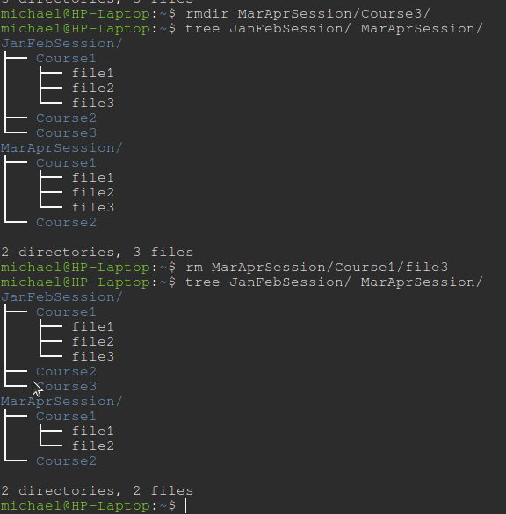
Copy and Remove Directories and Files
rmdir MarAprSession/Course3/
  remove directory MarAprSession/Course3
cp source destination
  copy source file to destination
  -r option copies directories recursively
mv source destination
  move source file to destination directory

Slide 6
Locate Directories and Files
locate -i pattern
  list files in database that match pattern
  file name database stores list of files
  update database with updatedb
find . -iname “text”
  find file with text in name
  ignore case
  starting in current directory

Slide 7
Creating shell scripts
Shell scripts are executable files containing bash commands
First line must be “#!/user/bin/bash”
usr/bin/bash may be different depending on distribution
Can contain
  for loops
  if/else statements
  variables
  functions
Execute permission must be given to user or group
  chmod u+x filename

Slide 8
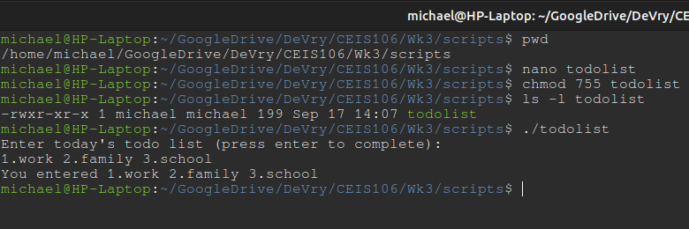
Changing Script File Permissions
chmod u+x filename
  adds execute permission for current user on filename
chmod 744 filename
  change files permissions
    user: read, write, execute
    group: read only
    all others: read only

Slide 9
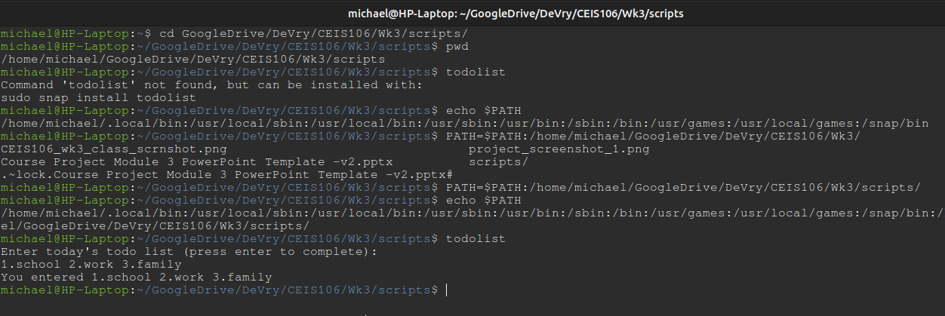
Set PATH Variable
echo $PATH
  prints current PATH vale
PATH=$PATH:/home/user/
  Adds “:/home/user/” to end of current PATH value

Slide 10
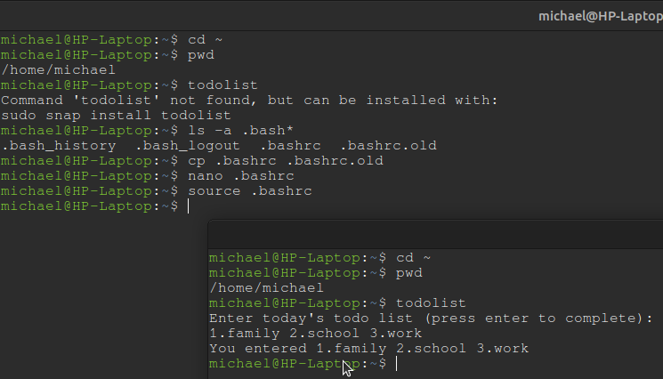
Make The PATH Value Permanent
Add desired filepath to end of .bashrc file
nano .bashrc
  open .bashrc in nano editor
bashrc
  file containing configuration data for shell
  located in users home directory

Slide 11
Add Users and Groups in Command Line
useradd command
  add new user to system
  use options to configure user account specifics
  uses default config settings if not specified in command
adduser command
  Like useradd
  Will prompt for password and user information
  Typically preferred method
addgroup command
  add new group to system
  assigns group id (GID)

Slide 12
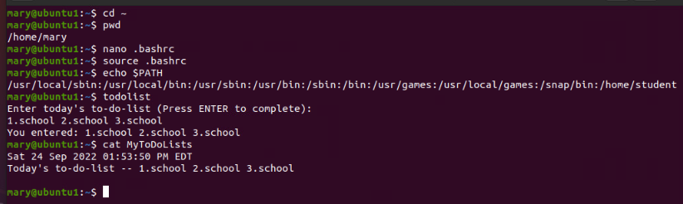
Test User and Group Settings
id username
  print username’s:
    userid (UID)
    groupid (GID)
    GID’s user belongs to
cat /etc/passwd
  prints passwd file listing all users
cat /etc/shadow
  prints all users with password hashed

Slide 13
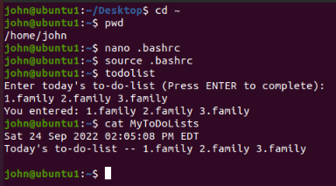
Add Users In GUI
GUI user management tools
  system-config-users
    Red Hat developed
    RHEL/CentOS distros
    yum install system-config-users
    yum groupinstall “Graphical Administration Tools”
  gnome-system-tools
    Debian based distros
    apt install gnome-statem-tools

Slide 14
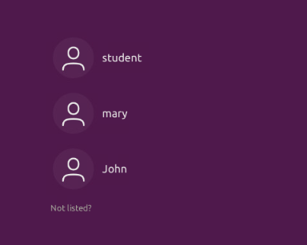
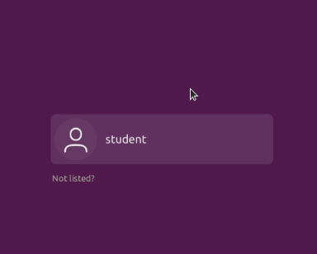
Remove Users and Groups
userdel username
  Removes user from system
  Deletes all entries referring to the username
groupdel group_id
  Removes group from system
  Deletes all entries referring to group
deluser and delgroup
  friendlier than previous two commands
  only removes data if command line options are used
  Leaves user’s home directory and files intact by default

Slide 15
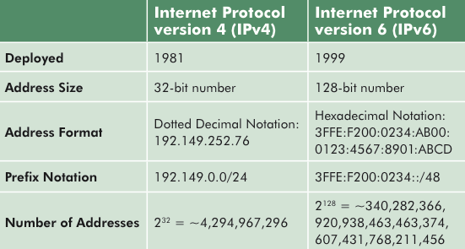
Networking
Networking
  Connecting more than one computer together for sharing data
  All connected computers must have an IPv4 or IPv6 address
TCP/IP
  Transmission Control Protocol/Internet Protocol
  Primary data transfer protocol used on the internet
IPv4 addresses
  Four octets of numbers
  eg. 192.168.0.1
IPv6
  Eight 16bit hexadecimal numbers
  eg. 2001:0db8:3c4d:0015:0000:0000:adb6:ef12
  Created because IPv4 addresses will all be used up
source: wikimedia.commons.org

Slide 16
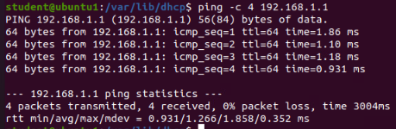
Discover Host IP Configurations
ifconfig command
  lists network devices installed
  Shows:
    IP addresses
    Current status of each device
route and netstat commands
  View/modify network tables

Slide 17
Manage Network Interfaces
ifconfig command
  View network configuration
  Configure network interfaces/devices
DHCP - Dynamic Host Configuration Protocol Client
dhclient command
  allows configuration of network interfaces with DHCP
Name Resolution
  DNS (domain name space) server
  FQDN – fully qualified domain name
  DNS servers store mapping of host FQDN to IP address
  Clients request host name from DNS server
  DNS server provides matching IP for proper connection

Slide 18
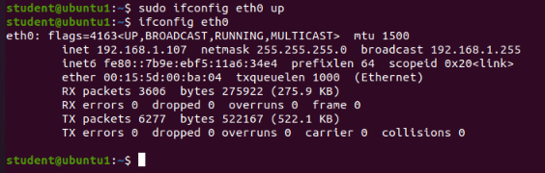
Using Network Utilities
ifconfig eth0 up
  Activates eth0 eithernet device
ifconfig eth0 down
  Deactivates eth0 device
ping 192.168.1.107
  Requests echo response from a host
ping -c 3 hostname
  Stop pinging after 3 attempts

Slide 19
Monitor Linux Processes
Performance Issues can be caused by:
  Hardware improperly configured
  Applications hogging resources
  Too many processes running
  File system excessive read/write operations
  Large amounts of network traffic
  Memory leaks, memory not being relinquished
Some Solutions:
  Using peripheral processing devices
  Adding RAM
  Using SSDs, especially NVME hard drives
  Run performance utilities to identify culprits

Slide 20
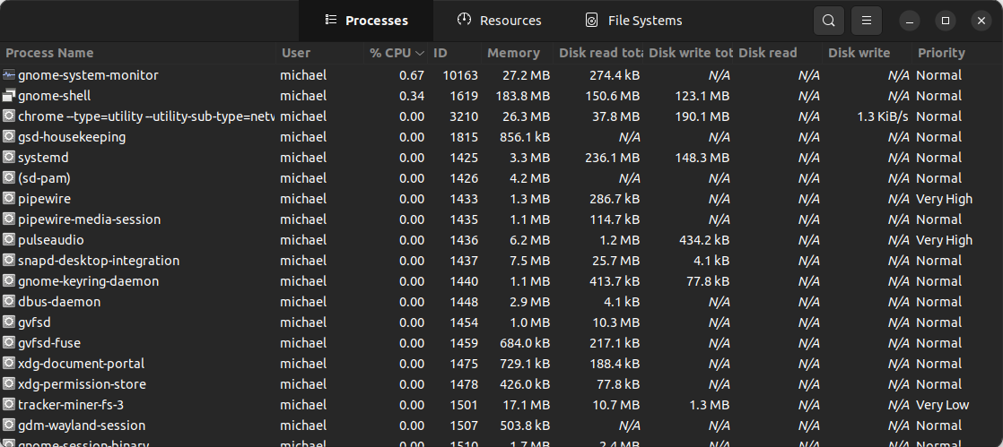
System Monitoring Utilities
HTOP
  used to observe all running processes
  Shows command line arguments used for process
  Can be used to kill a process
System Monitor
  GUI application
  Similar functionality to HTOP
  Can be used to kill a process

Slide 21
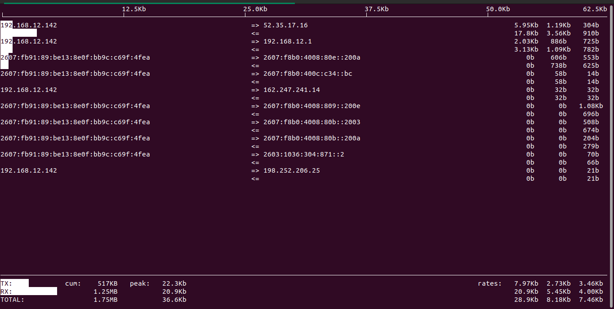
Network Bandwidth Usage
iftop utility
  Listen to network traffic
  Must be run as root
  Counts packets that pass through set filter

Slide 22
Challenges
Virtual Machine instances used for weekly projects were complex to set-up and slow.
The lesson lab assignments on MindTap were difficult to understand. The instructions were not clear and lead to a lot of guessing before moving to the next step.
Network configuration and monitoring processes were a challenge to fully understand and remember. It will take more reading and practice to fully grasp these concepts.

Slide 23
Skills Gained
Linux command line usage
BASH scripting
Linux user/group administration
Operating Linux virtual machine instances
Organizing and presentation of lessons learned
LibreOffice Impress – Linux based PowerPoint alternative

Slide 24
Conclusion
Linux is a widely used and adaptable operating system
There is a learning curve, but it’s worth the effort
Free and Open Source software can be very effective
Linux administration as a skill is very valuable

